Slide 1
Monetary and Fiscal Policy coordination: game theory perspective
Gulnara Nolan, Matt Nolan and Vladimir Petkov
ER Thursday coffee 12 December

Slide 2
Motivation
In Recommendation 3 of the RBA review, the importance of fiscal-monetary coordination was highlighted.
This recommendation justifies further work on how the policies mechanically influence each other – but in this presentation we discuss the tension due to non-cooperative strategic motives.
Fiscal and monetary actions both post-GFC and post-COVID have involved what looks like “pre-commitment” actions by governments and central banks – costly Budget announcements, communication on interest rate paths, quantitative easing, debates about central bank independence.
These motives imply that modelling strategic behaviour matters.
Can game theory be used to understand and model this relationship?
Notes:
Endogenous independence means that the central bank or fiscal authority can set up a costly structure to commit to actions in the future – they could do this by making it costly to change their behaviour, by increasing their future benefit of doing something, by manipulating their own objective function. Ultimately, we can show that agents in a non-cooperative game will have an incentive to select into a “inefficient” rule or impose a cost on changing their announced behaviour, in order to influence the future decisions of the other party they are in a non-cooperative game with.
What is an example. If the central bank was to announce they will hold interest rates at zero until a certain date, it is costly for them to change that – in terms of reputation. If the central bank purchases bonds, there is a monetary cost associated with lifting interest rates that will prevent them from doing so. If the government commits to an annual budget process, their ability to introduce discretionary changes in policy will be restricted and more costly to introduce. All of these common fiscal and monetary policy settings in the current institutional environment look like pre-commitment devices.
For the final bullet – a key point not made in the game theory of monetary policy literature is how different the game is given different economic shocks. A supply shock and a demand shock lead a very different “conflict” between monetary and fiscal authorities.

Slide 3
Motivation
Why does this matter?
Insufficient stimulus post-GFC.
Excessive stimulus post-COVID.
Both scenarios suggest that fiscal and monetary authorities may have been engaged in a non-cooperative game.
Has growing policy stickiness (pre-commitment) exacerbated this game? Does the type of shock matter?
Notes:
Endogenous independence means that the central bank or fiscal authority can set up a costly structure to commit to actions in the future – they could do this by making it costly to change their behaviour, by increasing their future benefit of doing something, by manipulating their own objective function. Ultimately, we can show that agents in a non-cooperative game will have an incentive to select into a “inefficient” rule or impose a cost on changing their announced behaviour, in order to influence the future decisions of the other party they are in a non-cooperative game with.
What is an example. If the central bank was to announce they will hold interest rates at zero until a certain date, it is costly for them to change that – in terms of reputation. If the central bank purchases bonds, there is a monetary cost associated with lifting interest rates that will prevent them from doing so. If the government commits to an annual budget process, their ability to introduce discretionary changes in policy will be restricted and more costly to introduce. All of these common fiscal and monetary policy settings in the current institutional environment look like pre-commitment devices.
For the final bullet – a key point not made in the game theory of monetary policy literature is how different the game is given different economic shocks. A supply shock and a demand shock lead a very different “conflict” between monetary and fiscal authorities.
Modelling
“cooperative” vs “noncooperative” responses to shocks,
Pre-commitment to policy settings through sequential games,
Endogenous independence as costly pre-commitment?
Policy targets, target asymmetry, and outcomes (i.e. can government deal with the inequality consequences of monetary policy).

Slide 4
Motivation
Graphs
Notes:
Endogenous independence means that the central bank or fiscal authority can set up a costly structure to commit to actions in the future – they could do this by making it costly to change their behaviour, by increasing their future benefit of doing something, by manipulating their own objective function. Ultimately, we can show that agents in a non-cooperative game will have an incentive to select into a “inefficient” rule or impose a cost on changing their announced behaviour, in order to influence the future decisions of the other party they are in a non-cooperative game with.
What is an example. If the central bank was to announce they will hold interest rates at zero until a certain date, it is costly for them to change that – in terms of reputation. If the central bank purchases bonds, there is a monetary cost associated with lifting interest rates that will prevent them from doing so. If the government commits to an annual budget process, their ability to introduce discretionary changes in policy will be restricted and more costly to introduce. All of these common fiscal and monetary policy settings in the current institutional environment look like pre-commitment devices.
For the final bullet – a key point not made in the game theory of monetary policy literature is how different the game is given different economic shocks. A supply shock and a demand shock lead a very different “conflict” between monetary and fiscal authorities.
Modelling
“cooperative” vs “noncooperative” responses to shocks,
Pre-commitment to policy settings through sequential games,
Endogenous independence as costly pre-commitment?
Policy targets, target asymmetry, and outcomes (i.e. can government deal with the inequality consequences of monetary policy).

Slide 5
What we do
We outline theoretical relationships between monetary and fiscal policies that may occur in the face of uncoordinated action using concepts from non-cooperative game theory.
We extend the current literature to include
dynamic strategic motives
The ability for policy makers to pre-commit in opposition to each other
The importance of adjustment costs and the choice of stickiness for generating these outcomes
We find that individual rationality by policy makers to independently pre-commit to courses of action may generate worse outcomes for both monetary and fiscal decision makers (depending on the shock)
While we possess an understanding of how these policies affect output and inflation, their effects on inequality remain less clear. Additionally, it is essential to investigate whether the government and the central bank prioritise inequality in their decision-making.
Notes:
Introduction:
Monetary policy independence matters for anchoring inflation expectations and mitigating the “time inconsistency” problem that exists between government and the public with regards to monetary policy. However, the crises of the last 20 years have shown that there are limits to this independence – and a blurry line between what constitutes fiscal and monetary policy. Quantitative easing, forward guidance, and fiscal dominance are all active policy areas of research where the relationship between fiscal and monetary policy rules becomes complex. In this piece we hope to inform these debates.
Monetary-fiscal coordination can reflect two separate concerns:
1) Crisis management: The timing, size, and information about announcements may be better organised in the short-term to make sure that responses to a crisis are effective and measured.
2) Objective relationships: The fiscal and monetary policy rules may interact in unintended ways relative to a welfare maximising dynamic path, in ways that may be difficult to tease out. These may situations where policies offset, or where they support each other.
We believe that non-cooperative game theory – specifically a dynamic game with policy adjustment costs – can provide novel insights into this second form of monetary-fiscal coordination, the nature of fiscal and monetary policy rules, and potential pitfalls of strict monetary or fiscal leadership/independence.
########################
It is common to look at fiscal and monetary policy decision making separately when analysing optimal policy – with the Kyland Prescott (1977) motivation for independence due to time inconsistency being used as a justification for an independent central bank, which weighs inflation more heavily than a “social planner” would. Since the Global Financial Crisis, it has become clearer that monetary and fiscal authorities' roles can be intertwined, and that there are benefits from coordination. Furthermore, forward guidance and debate about fiscal dominance and monetary policy offset have become major areas of investigation. There are two ways that coordination/cooperation matter: 1) Crisis management: The timing, size, and information about announcements may be better organised in the short-term to make sure that responses to a crisis are effective and measured.
2) Objective relationships: The fiscal and monetary policy rules may interact in unintended ways relative to a welfare maximising dynamic path, in ways that may be difficult to tease out. These may situations where policies offset, or where they support each other.
We believe that non-cooperative game theory – specifically a dynamic game with policy adjustment costs – can provide novel insights into this second form of monetary-fiscal coordination, the nature of fiscal and monetary policy rules, and potential pitfalls of strict monetary or fiscal leadership/independence. #################################### Few comments:
What is the role of expectations in the game? Do/ can we incorporate it?
Why do we need to generalise the model?
What is the question we are trying to answer?
Based or on top of what has already been done, what explicitly are we proposing?

Slide 6
Literature
Monetary commitment and delegation
Kydland and Prescott (1977), canonical model of time inconsistency in monetary policy/need to pre-commit.
Coury and Petkov (2010), explicitly models the sequential delegation decision by fiscal authorities the allows for pre-commitment (also applies a strategic investment as below but to a principal-agent problem).
Strategic investment
Dixon (1985), illustrates how firms may optimally “over-invest” for strategic reasons.
Dixit (1997), highlights the use of adjustment costs a form of pre-commitment.
Monetary-fiscal trade-offs/choices
Benigno and Woodford (2003), describes a linear-quadratic macro-model that solves for optimal policy paths (however, it does not allow for strategic interactions between government and monetary policy).

Slide 7
Literature
Monetary-fiscal coordination as a game
Debelle and Fischer (1994), solves for optimal central bank independence in a NE, and sequential games with monetary policy leading.
Dixit and Lambertini (2003), shows interactions of commitment in monetary and fiscal policies in a static game.
Ali al-Nowaihi and Sanjit Dhami (2011), looks at the DL model in a liquidity trap.
Barthélemy and Plantin (2018), describes a “chicken” game between fiscal and monetary authorities that cannot fully commit – and embeds it in a fully dynamic game.
Stawska et al (2019), shows the Nash equilibrium for the non-cooperative game between monetary and fiscal policy with asymmetric objective functions.
Camous and Matveev (2022), includes repeated commitment to analyse optimal strategic monetary policy rules where monetary credibility rises with fiscal influence (as opposed to fiscal dominance).
Instrument rigidities
Woodford (1999), describes optimal monetary policy inertia and interest rate smoothing
Notes:
https://citeseerx.ist.psu.edu/document?repid=rep1&type=pdf&doi=a6927bf59e9025ec16d3c9b9471c605972e5575c
Dynamic game is important, because “precommitment” and potential failures/successes from that require a dynamic game.

Slide 8
Literature
Other monetary/fiscal policy games
Alesina (1987), solves for NE when policies are discretionary and there is competition between two political parties who weight output and inflation differently.
Leeper (1991), develops a framework where fiscal and monetary policies are classified as either active or passive, depending on their behaviour. It explores how the strategic interaction between the two can result in different macroeconomic outcomes.
Notes:
https://citeseerx.ist.psu.edu/document?repid=rep1&type=pdf&doi=a6927bf59e9025ec16d3c9b9471c605972e5575c

Slide 9
Expected contribution
We will provide a dynamic strategic game of monetary and fiscal policy setting, allowing for “strategic pre-commitment”.
To our knowledge, the first dynamic strategic game of monetary and fiscal policy setting.
Linking past policy to the current state generates a dynamic strategic component to monetary-fiscal coordination that is understudied.
Provides a fuller understanding of “commitment” and leadership.
A first approach that recognises the different game played given different shocks (supply and demand shocks differ in the substitutability and complementarity of choices).
Will also dynamically model the “choice” of commitment regime by fiscal and monetary authorities
Highlights a possible policy failure if both fiscal and monetary authorities compete over commitment.
Today’s model is a simple static framework to highlight what we intend to model more fully over the coming months.
Notes:
To sum up, our main contributions are:
A dynamic game theory model that allows for pre-commitment.
A discussion of how monetary fiscal conflict varies on the basis of supply vs demand shocks.
Endogenous determination of commitment regimes and their relation to social welfare.

Slide 10
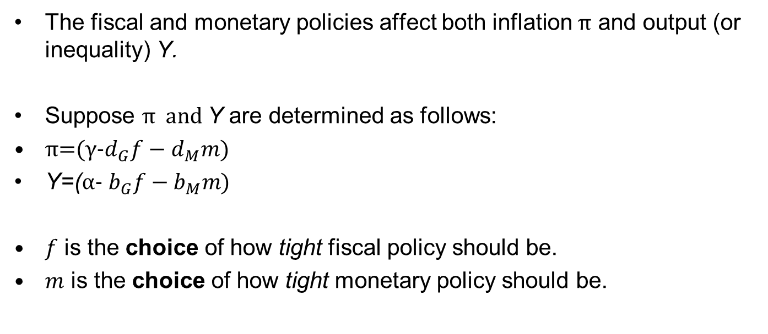
Simple Model
The fiscal and monetary policies affect both inflation π and output (or inequality) Y.
Suppose π and Y are determined as follows:
π=(γ-$d_{G}f−d_{M}m)$
Y=(α- $b_{G}f−b_{M}m)$
$f$ is the choice of how tight fiscal policy should be.
$m$ is the choice of how tight monetary policy should be.
Notes:
We only started this 2 weeks ago, so we have stuck with a very simple model to show the “tendencies” we believe a more complex macro-game theory model will involve.
Example: dg is the sensitivity of inflation to tightness in fiscal policy.

Slide 11
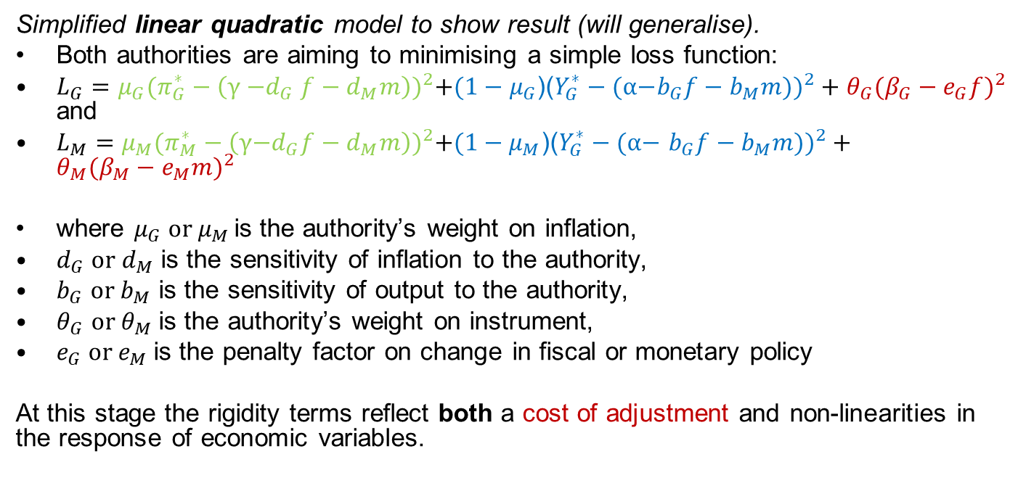
Model (static game)
Simplified linear quadratic model to show result (will generalise).
Both authorities are aiming to minimising a simple loss function:
$L_{G}=μ_{G}{(π_{G}^{∗}−\left(\text{γ}{\text{−}d}_{G}f−d_{M}m\right))}^{2}+(1−μ_{G}$)(${Y_{G}^{∗}−(\text{α}\text{−}b_{G}f−b_{M}m))}^{2}+θ_{G}({β_{G}−e_{G}f)}^{2}$ and
$L_{M}=μ_{M}{(π_{M}^{∗}−\left(\text{γ}\text{−}d_{G}f−d_{M}m\right))}^{2}+(1−μ_{M}$)(${Y_{G}^{∗}−(\text{α}\text{−} b_{G}f−b_{M}m))}^{2}+θ_{M}({β_{M}−e_{M}m)}^{2}$
where $μ_{G} or μ_{M }$is the authority’s weight on inflation,
$d_{G} or{ d}_{M}$ is the sensitivity of inflation to the authority,
$b_{G}$ or $b_{M}$ is the sensitivity of output to the authority,
$θ_{G}$ or $θ_{M}$ is the authority’s weight on instrument,
$e_{G}$ or $e_{M}$ is the penalty factor on change in fiscal or monetary policy
At this stage the rigidity terms reflect both a cost of adjustment and non-linearities in the response of economic variables.
Notes:
Note: The social welfare function may be different again from these loss functions. DL (2003) estimate a social welfare function when talking through their results, while Coury and Petkov (2010) have the fiscal authorities objective as the social welfare function, and are trying to deal with concerns about time commitment and the role of delegation.
The idea is as follows. The social planner wants to maximise social welfare. However, it sets things up such that each authority – fiscal or monetary – only chooses a single objective and is responsible for it with its single target. In this case, we will set Mg to 0 and Mm to 1 so that government only thinks about output and the monetary authority only thinks about inflation.
In this case, we may have a social planner that values both output deviations and inflation deviations equally, and they have split these responsibilities because they expect the authorities to achieve this end. In fact, if the two “cooperate” they will behave in this way.
The only complication is how we view the “adjustment” cost. If that is part of social welfare then we can view the cooperative outcome as equivalent to the welfare maximizing outcome. If instead it is a psychic cost on the institution alone, and not part of social welfare, these will be different.

Slide 12
Precommitment
What is pre-commitment?
A government budget.
A published path for interest rates.
The sequencing of announcements/choices.
A friction in changing policy.
Costly commitment to a rule.
In our static game we simply assume that a player “moves first” (Stackelberg game). In a dynamic game this will be about “costs of adjustment”.
Notes:
Forward guidance, communication of information, and clear focal point dates for policy settings are all methods for “pre-committing”. As a result, the tools we use for independence of policy objectives to deal with time inconsistency concerns ALSO have a strategic element when it comes to policy setting between parts of government.

Slide 13
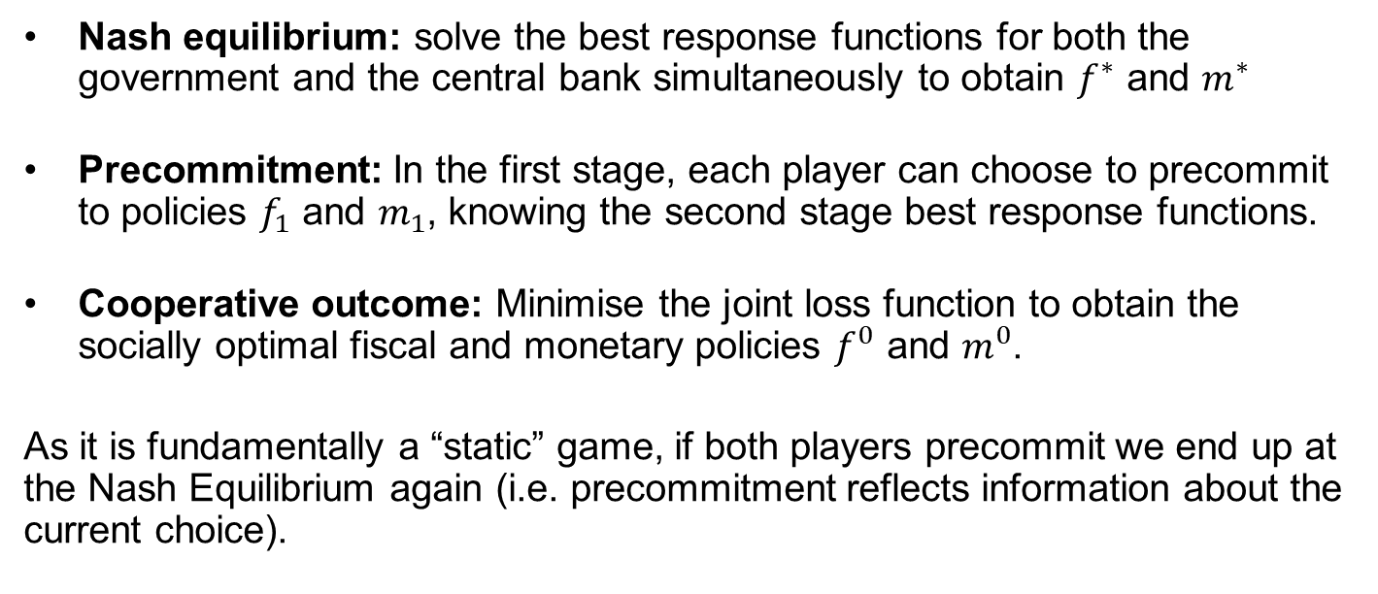
Summary of analytical solutions
Nash equilibrium: solve the best response functions for both the government and the central bank simultaneously to obtain $f^{∗}$ and $m^{∗}$
Precommitment: In the first stage, each player can choose to precommit to policies $f_{1}$ and $m_{1}$, knowing the second stage best response functions.
Cooperative outcome: Minimise the joint loss function to obtain the socially optimal fiscal and monetary policies $f^{0}$ and $m^{0}$.
As it is fundamentally a “static” game, if both players precommit we end up at the Nash Equilibrium again (i.e. precommitment reflects information about the current choice).

Slide 14
Modelling assumptions
Modelling Assumptions
Asymmetry in objectives: Monetary authority only weights inflation, government only growth (one target, one instrument)
Adjustment cost of instrument: Necessary to prevent “total offset” – otherwise Nash Equilibrium is indeterminant.
Rational expectations: Agents know and respond to the best response of other agents.

Slide 15
Types of games
Demand v supply shocks
Demand
Supply
Symmetric
Prisoners dilemma
Prisoners dilemma
Symmetry of objectives
Asymmetric
Prisoners dilemma
Coordination/offset game
Responses will differ. Role of pre-commitment/“instrument stickiness” will differ.
Varying costs of adjustment also change the cost/benefit of pre-commitment.
Notes:
For the varying costs point can talk about the “cost of adjusting from a target interest rate”. If that is zero in the demand shock then the nash equilibrium is still worse. But pre-commitment allows the cooperative equilibrium to be sustained. If there are significant costs, then it leads to a WORSE nash equilibrium.

Slide 16
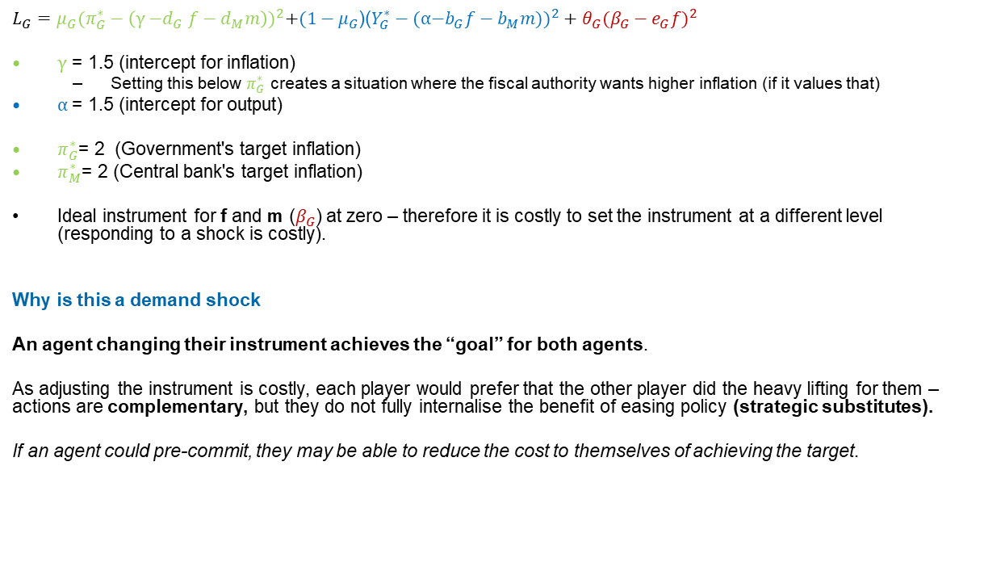
Static Demand shock
$L_{G}=μ_{G}{(π_{G}^{∗}−\left(\text{γ}{\text{−}d}_{G}f−d_{M}m\right))}^{2}+(1−μ_{G}$)(${Y_{G}^{∗}−(\text{α}\text{−}b_{G}f−b_{M}m))}^{2}+θ_{G}({β_{G}−e_{G}f)}^{2}$
$\text{γ}$ = 1.5 (intercept for inflation)
Setting this below $π_{G}^{∗}$ creates a situation where the fiscal authority wants higher inflation (if it values that)
$\text{α}$= 1.5 (intercept for output)
$π_{G}^{∗}$= 2 (Government's target inflation)
$π_{M}^{∗}$= 2 (Central bank's target inflation)
Ideal instrument for f and m ($β_{G}$) at zero – therefore it is costly to set the instrument at a different level (responding to a shock is costly).
Why is this a demand shock
An agent changing their instrument achieves the “goal” for both agents.
As adjusting the instrument is costly, each player would prefer that the other player did the heavy lifting for them – actions are complementary, but they do not fully internalise the benefit of easing policy (strategic substitutes).
If an agent could pre-commit, they may be able to reduce the cost to themselves of achieving the target.
Notes:
Necessary to make responding to a shock costly, otherwise there is no Nash Equilibrium in this game. We can view this as a form of “conservativeness” in behaviour, and in a more general macro-model this term won’t be necessary.
When both instruments are set to zero, both inflation and output are below their target levels, which is why this is a “demand shock”. We can imagine the game “started” with gamma and alpha at 2, and optimal policy at f = m = 0.

Slide 17
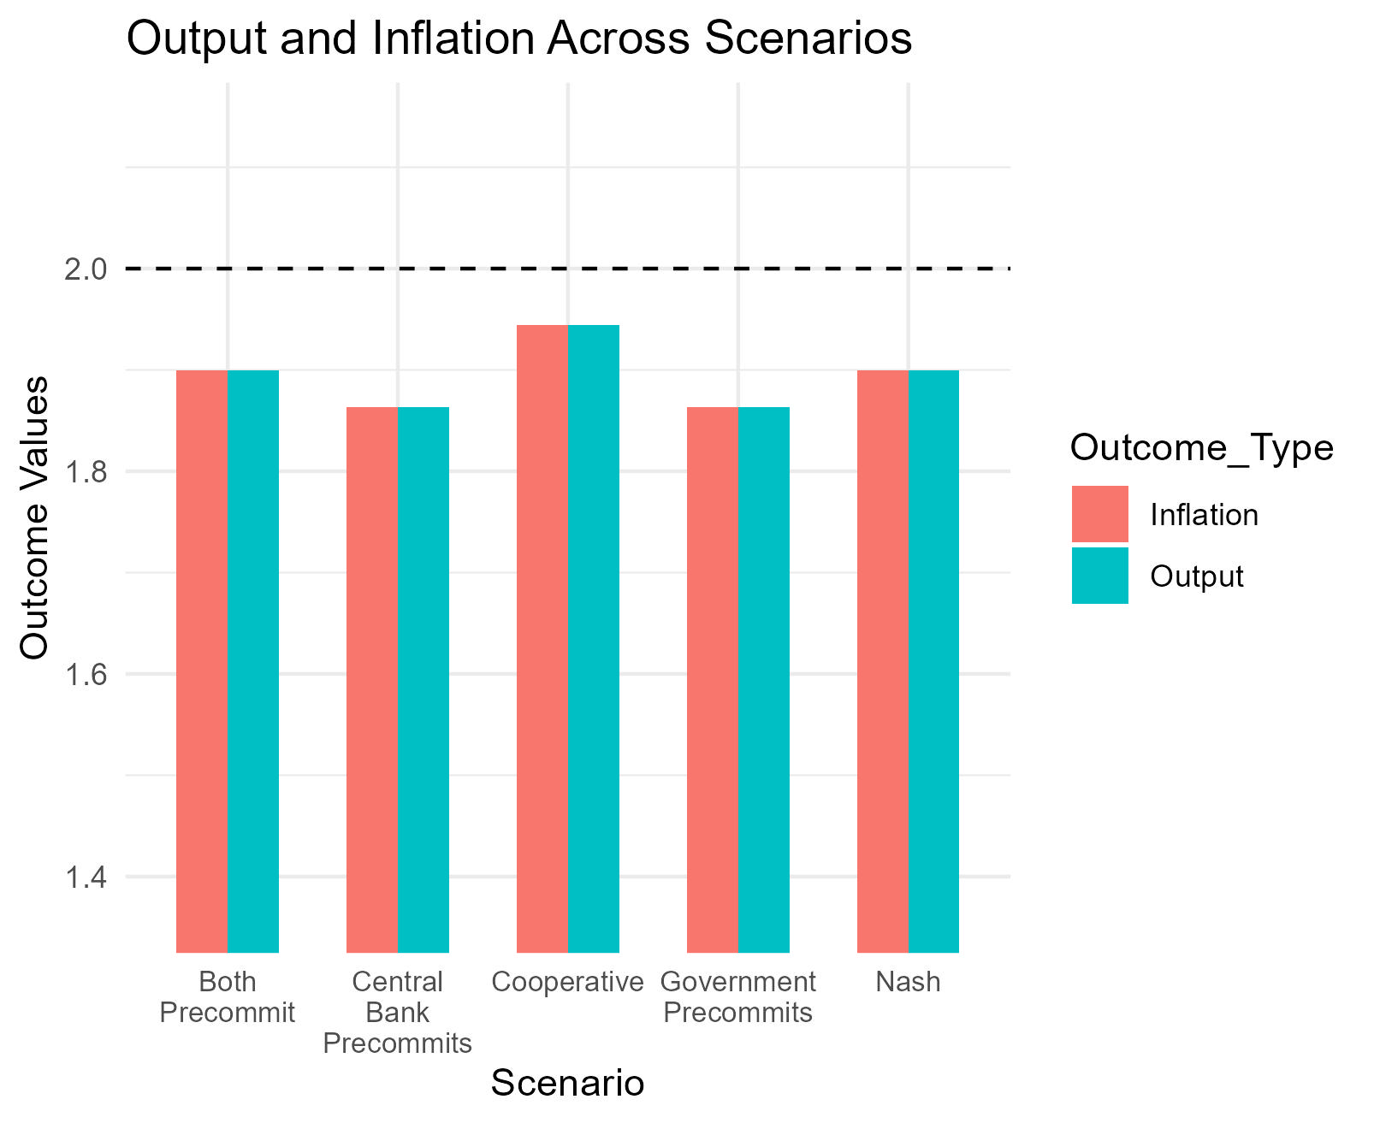
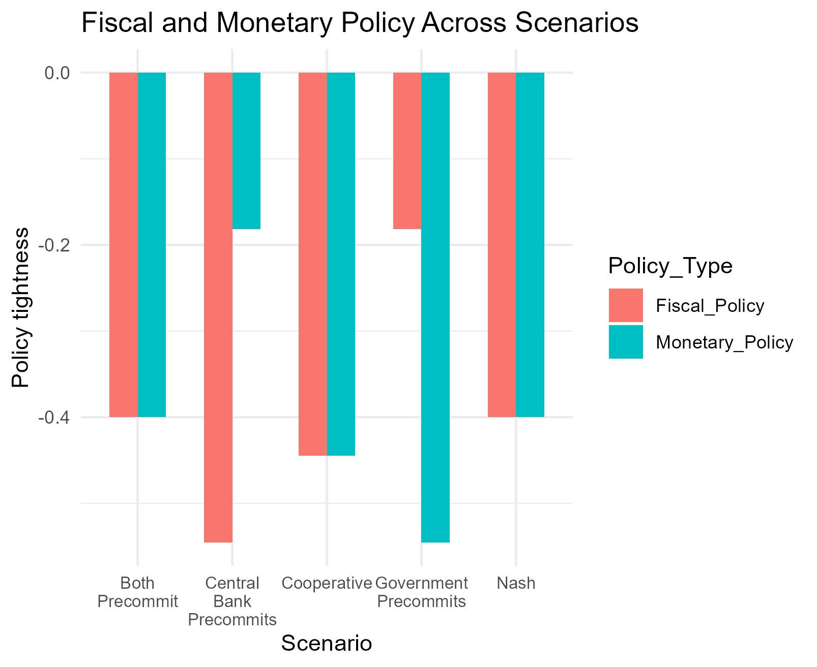
Choices (demand)
Notes:
Demand shock:
NE leads to less easing by both authorities after a demand shock.
“Pre-commitment” or “leadership” generates worse outcomes – unlike the other literature (i.e. Debelle and Fischer 1994). Why? Cost of policy adjustment generates a free-rider problem which gets worse with pre-commitment.
The idea here is that equilibrium play leads to “conservative” play by both fiscal and monetary authorities.

Slide 18
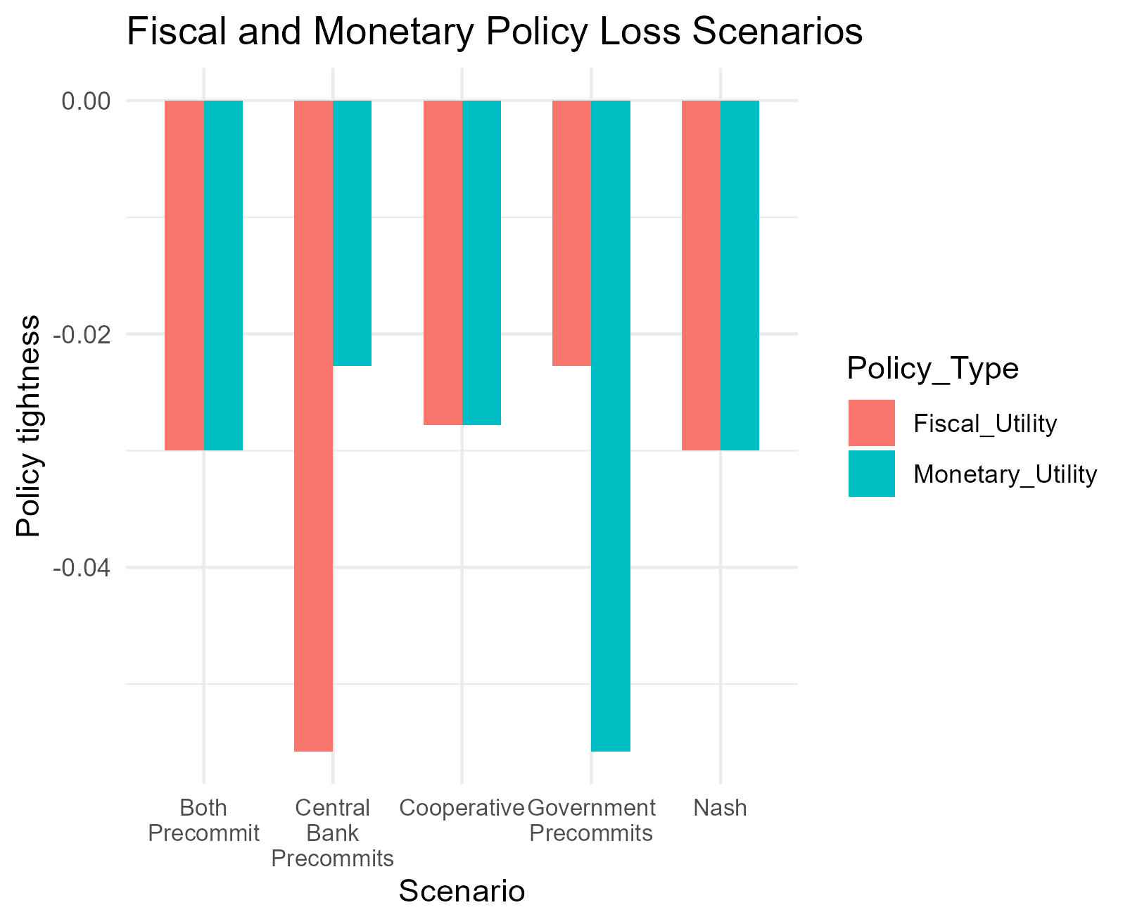
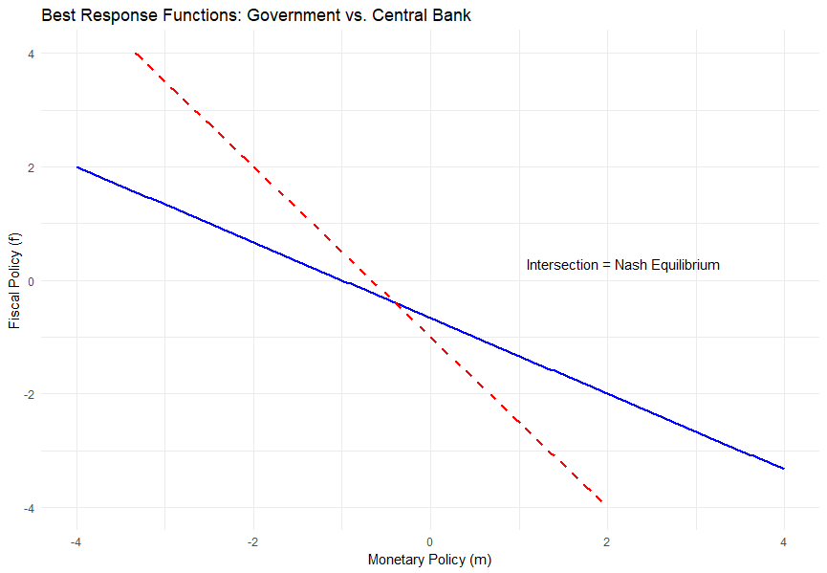
Payoffs (demand)

Slide 19
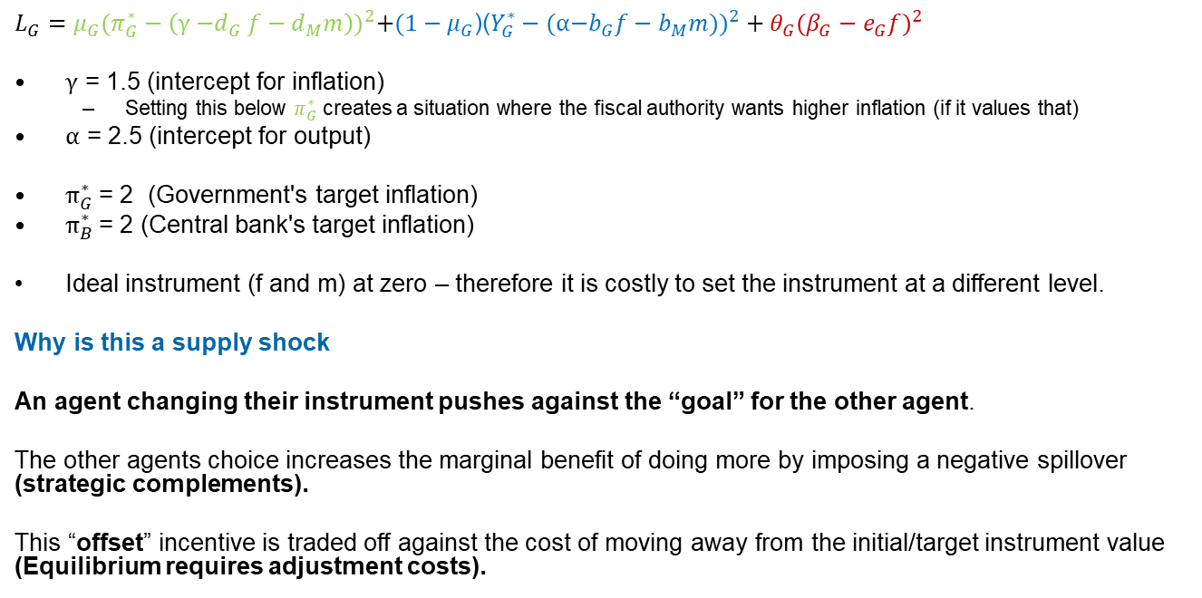
Static Supply shock (positive)
$L_{G}=μ_{G}{(π_{G}^{∗}−\left(\text{γ}{\text{−}d}_{G}f−d_{M}m\right))}^{2}+(1−μ_{G}$)(${Y_{G}^{∗}−(\text{α}\text{−}b_{G}f−b_{M}m))}^{2}+θ_{G}({β_{G}−e_{G}f)}^{2}$
$\text{γ}$ = 1.5 (intercept for inflation)
Setting this below $π_{G}^{∗}$ creates a situation where the fiscal authority wants higher inflation (if it values that)
$\text{α}$ = 2.5 (intercept for output)
$π_{G}^{∗}$= 2 (Government's target inflation)
$π_{B}^{∗}$= 2 (Central bank's target inflation)
Ideal instrument (f and m) at zero – therefore it is costly to set the instrument at a different level.
Why is this a supply shock
An agent changing their instrument pushes against the “goal” for the other agent.
The other agents choice increases the marginal benefit of doing more by imposing a negative spillover (strategic complements).
This “offset” incentive is traded off against the cost of moving away from the initial/target instrument value (Equilibrium requires adjustment costs).
Notes:
In this game “full offset” between monetary and fiscal authorities would lead to both instruments going in opposite directions to infinity, unless there is a constraint on their actions. This is the purpose of the “adjustment cost from target” in this loss function. In a macro-model equilibrium could be generated by relative economic responses to the instruments.

Slide 20
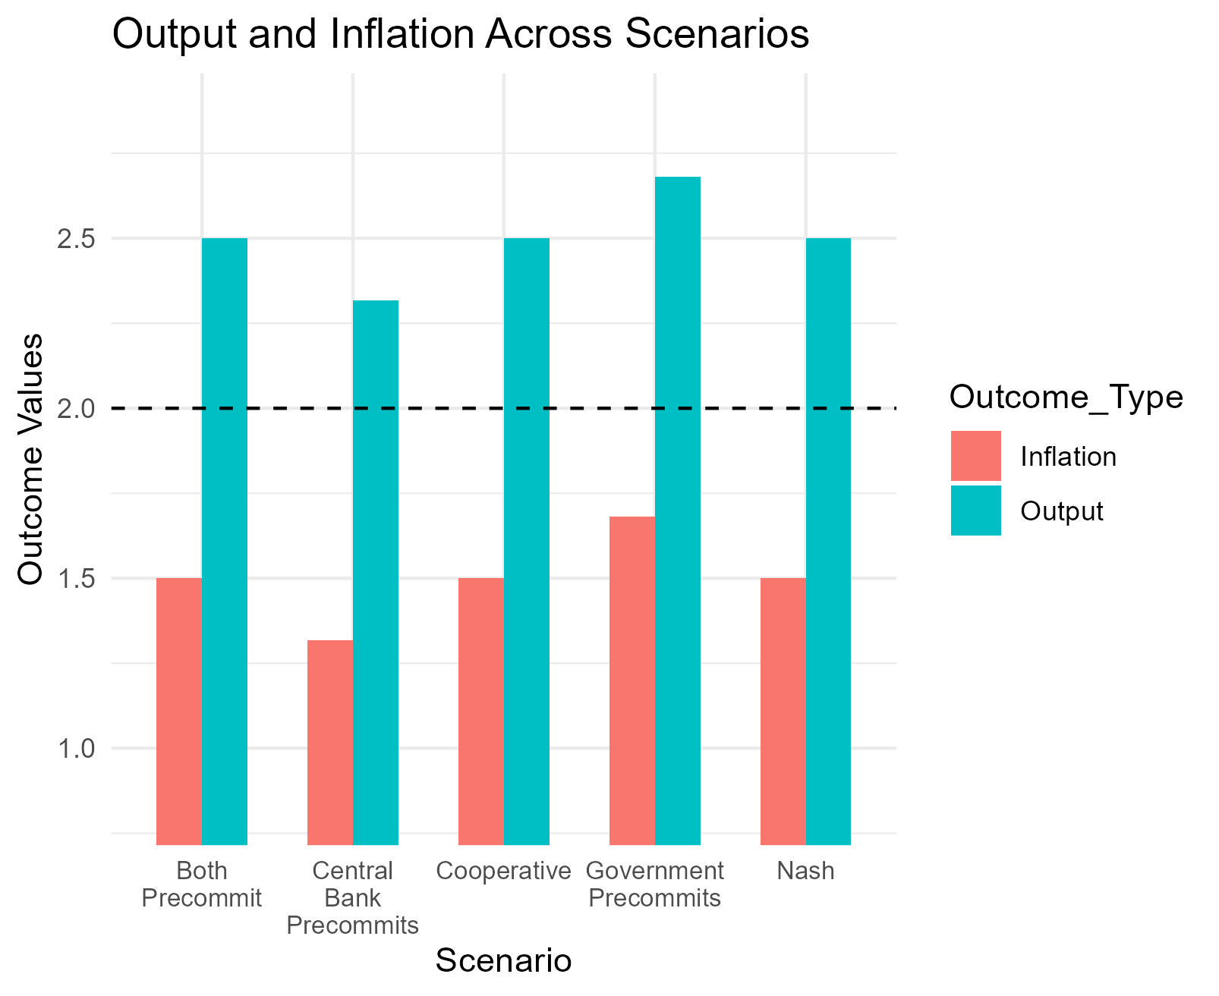
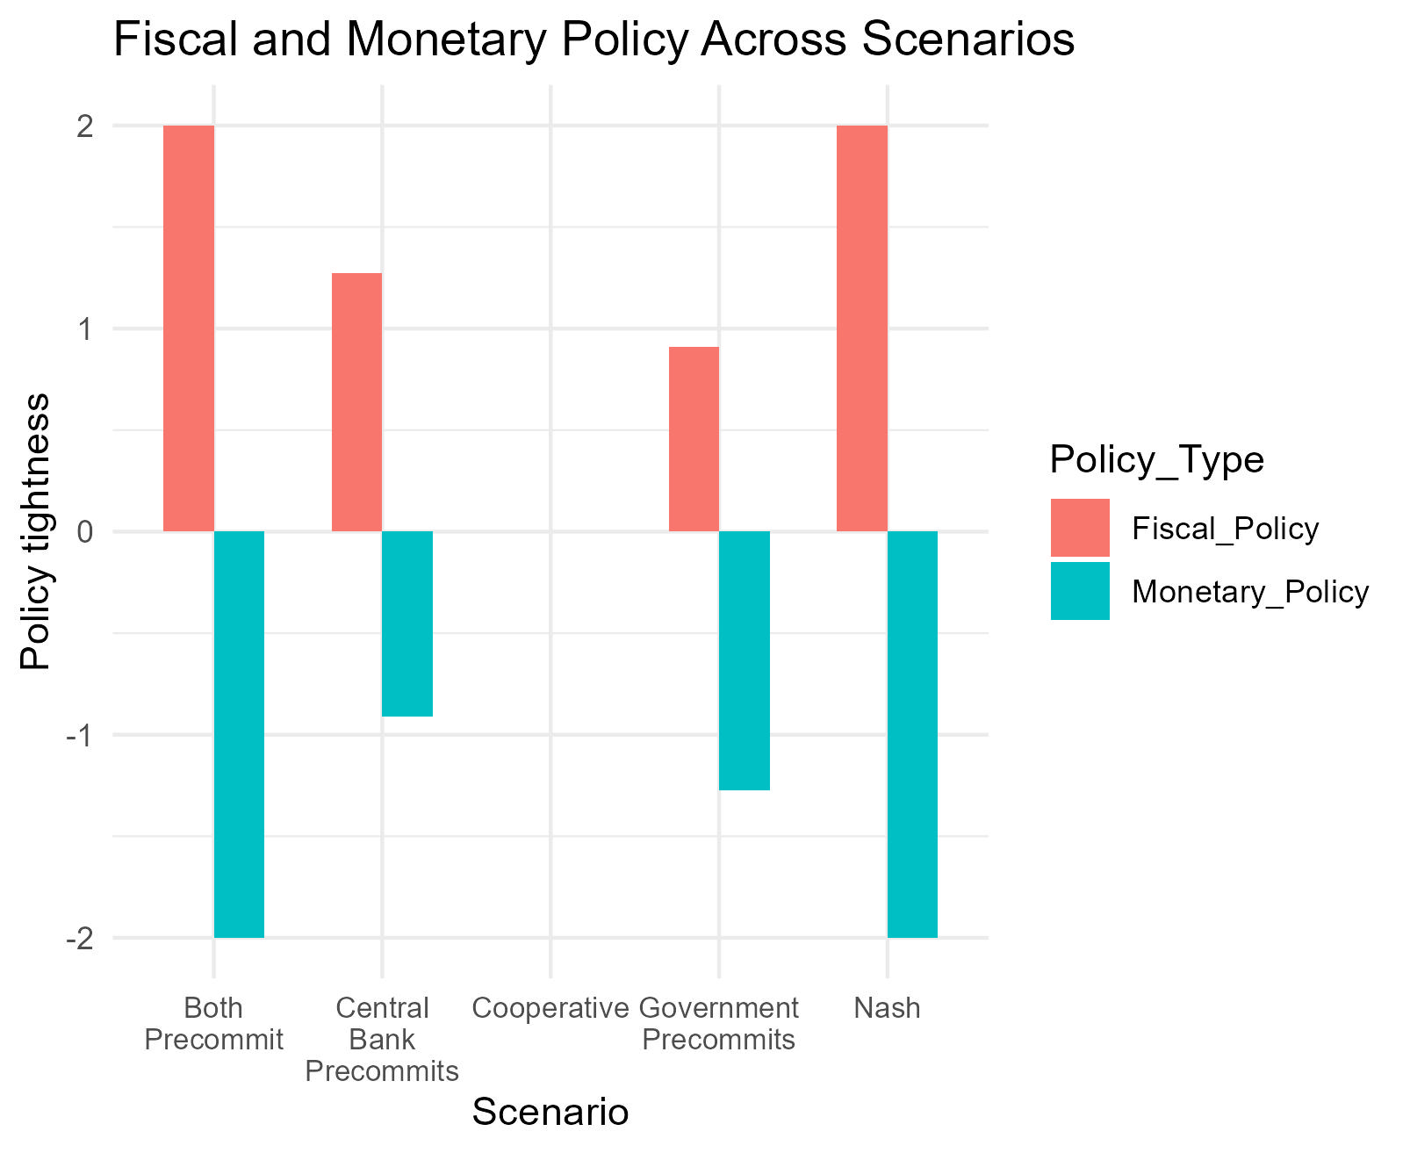
Choices (supply)
Notes:
Supply shock leads to:
Similar economic outcomes in NE and cooperative!
However, drastic change in relative policy settings in NE – if policy variability has a cost to social welfare then this is costly.
Pre-commitment/leadership generates a “second-mover advantage”. If the central bank pre-commits we end up with the lowest inflation outcomes, as the second mover determines which target we move closest to.

Slide 21
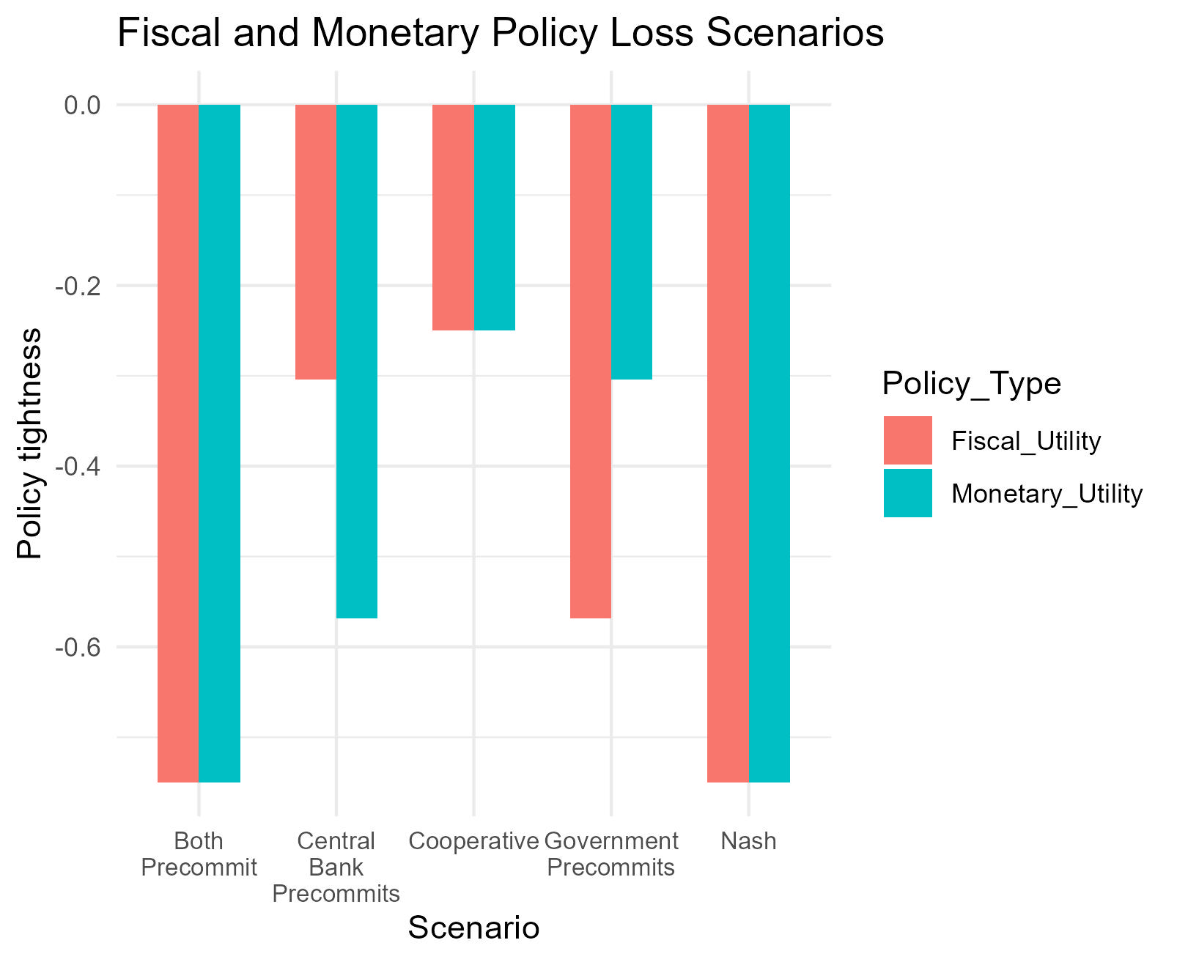
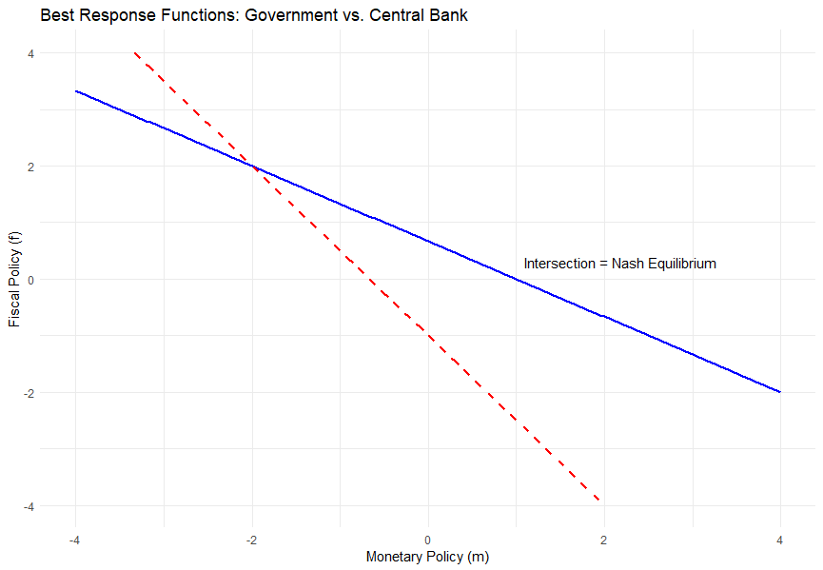
Payoffs (supply)
Notes:
The pre-commitment game reduces the “loss” to authorities through the cost of adjustment.
However, if social welfare does not care about adjustment costs, then the pre-commitment outcomes are the worst among all.

Slide 22
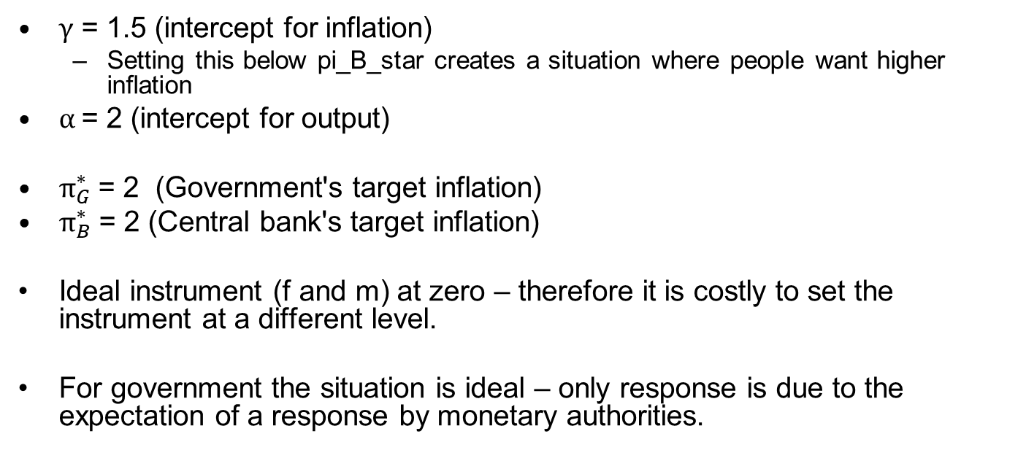
Inflation only shock
$\text{γ}$ = 1.5 (intercept for inflation)
Setting this below pi_B_star creates a situation where people want higher inflation
$\text{α}$= 2 (intercept for output)
$π_{G}^{∗}$= 2 (Government's target inflation)
$π_{B}^{∗}$= 2 (Central bank's target inflation)
Ideal instrument (f and m) at zero – therefore it is costly to set the instrument at a different level.
For government the situation is ideal – only response is due to the expectation of a response by monetary authorities.

Slide 23
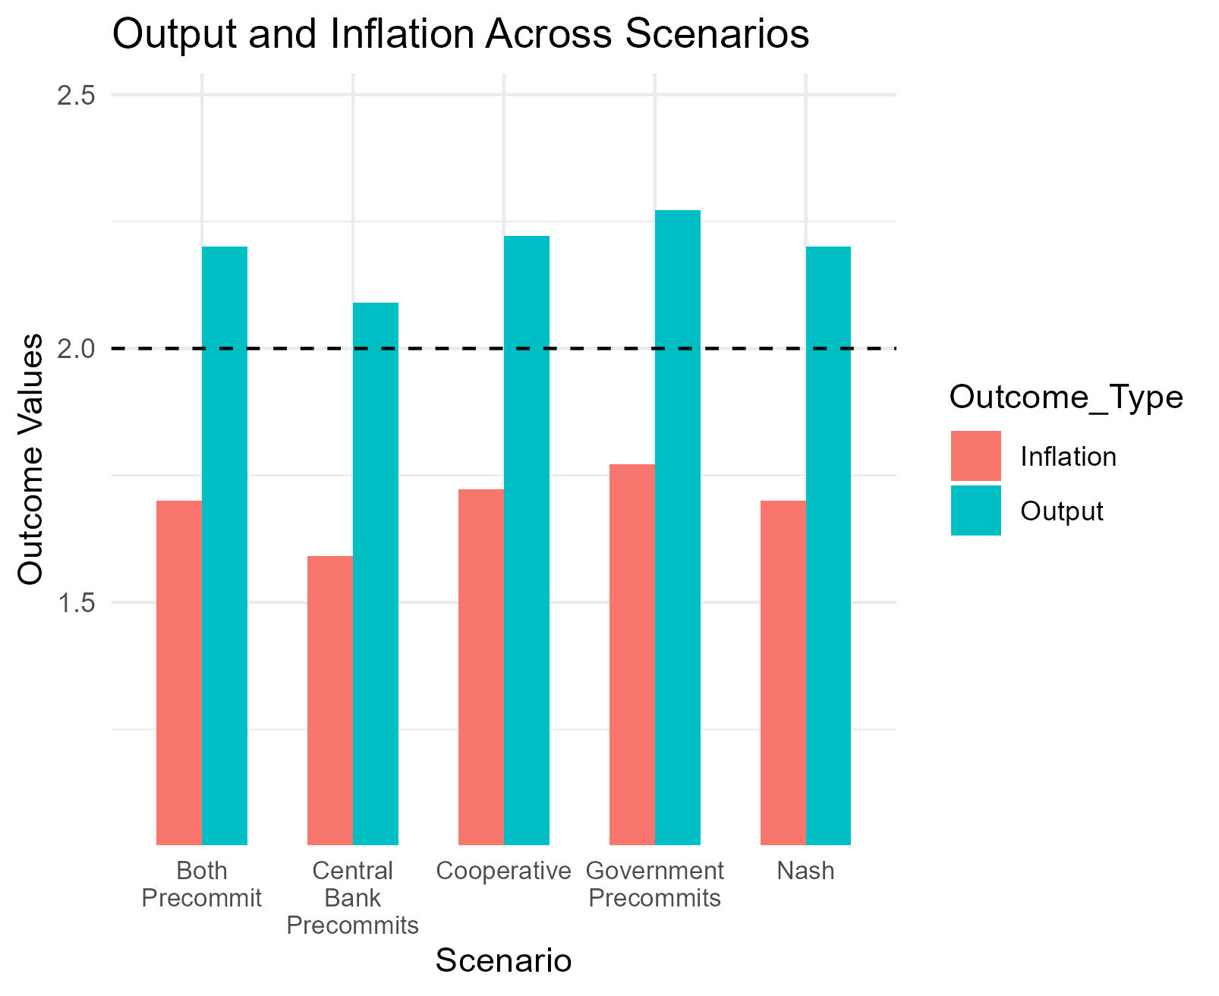
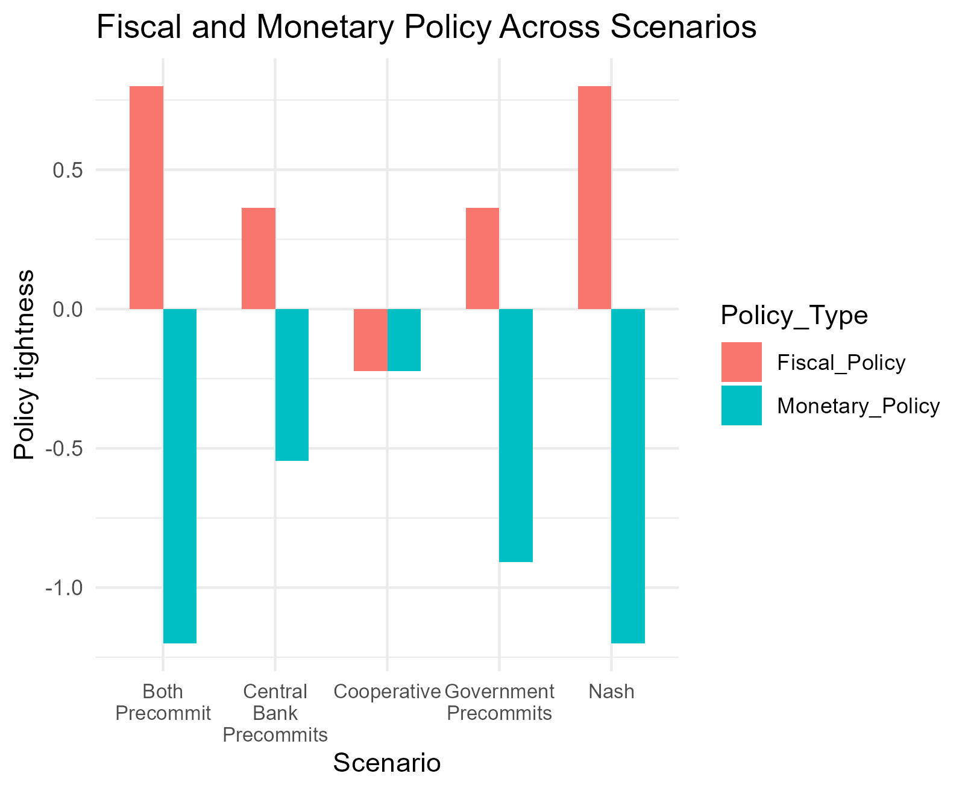
Payoffs
Notes:
1) Inflation only shock plays out similarly to the supply shock.

Slide 24
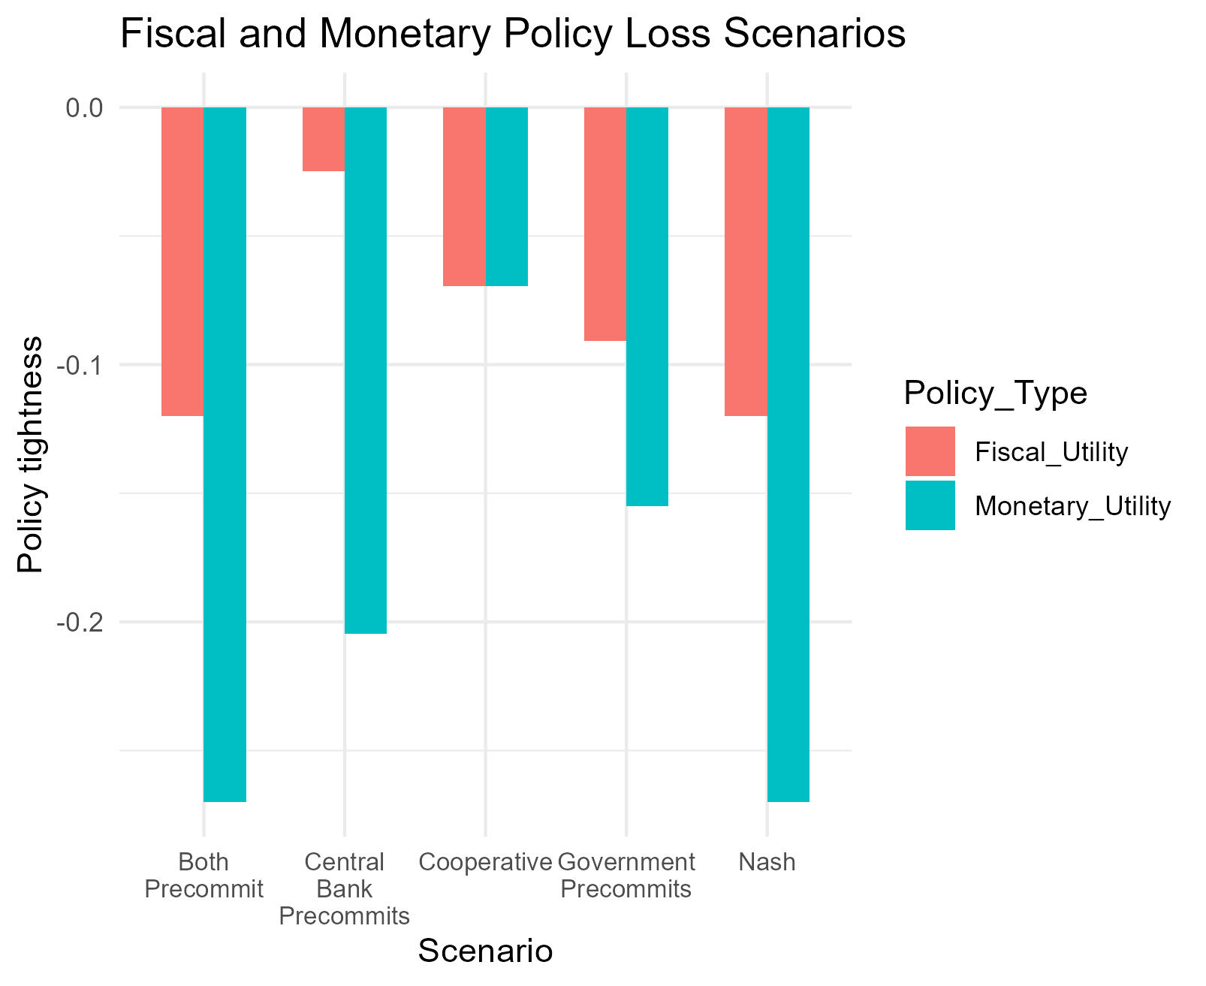
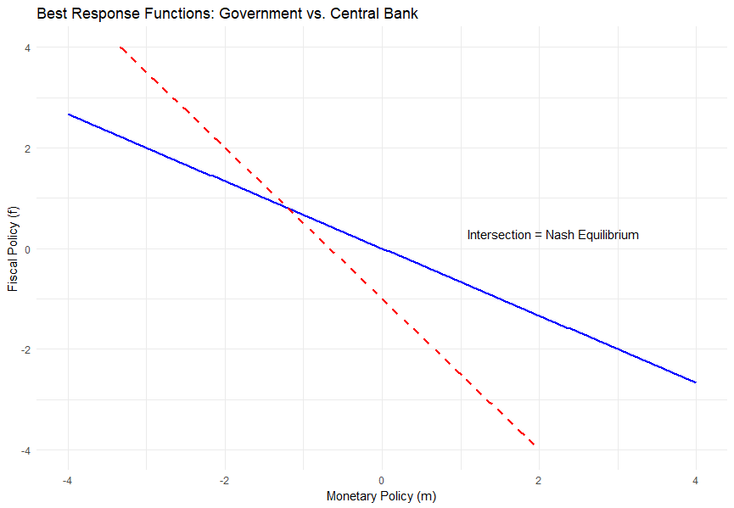
Payoffs

Slide 25
Dynamic game
Previously looked at a static model.
“Leadership” was just given. But leadership can be defined endogenously by adding a link between current choices and future payoffs.
The idea of “costly change in a policy instrument” – and therefore the idea of “precommitment” – require dynamics.
For this we will write a dynamic Stackelberg model of monetary policy.
Stages of this approach
Two-choice game: To show the value of the intertemporal link.
Dynamic choice game with shocks: Infinite horizon model, with differing expectations about the nature of future “shocks” (i.e. demand or supply shocks).
Endogenising “pre-commitment”: If monetary and fiscal authorities can undertake constrain themselves (independence) does this worsen outcomes.
Macro-model and incorporating time inconsistency: Allows us to describe “optimal independence” of monetary and fiscal policy.
Notes:
What is the logic – a Stackelberg model does not mean that one player moves first. It means that the other player KNOWS what that players choice will be. There is an infinite cost for the player from changing from the choice the other player anticipates. We can generate similar dynamics by reducing the size of the cost for changing behaviour. If there is an “adjustment cost” then a decision maker will be unwilling to adjust their behaviour if the benefit of moving to the true “optimum” is less than the cost of moving (i.e. menu cost models of the costs of inflation). As a result, by setting such a cost an individual is able to credibly commit to a different course of action than the static nash equilibrium.
Two-choice game shows how this works. Dynamic game allows us to describe the process, and to consider the endogenous choice of adjustment costs.
Then incorporating it into a macro-model will allow us to more richly describe outcomes, why this matters, and how government and monetary authorities respond to shocks.

Slide 26
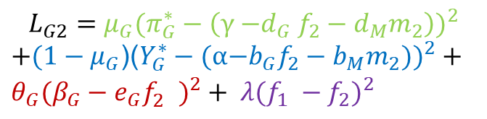
Early two-choice results
Approach
Shock lasts for two periods, and fiscal and monetary choices are made over both.
The intertemporal link between choices is the cost of adjusting for the policy chosen in the first period.
Can solve via backward induction.
Note: The purpose of this example is to show the link, we are now solving the infinite horizon game to understand this more fully.
Findings
Demand shock:
Leads to lower output and inflation than NE.
Both agents use “cost of adjustment” to pre-commit to lower policy easing.
Supply shock:
Coordination, NE, and pre-commitment generate same inflation and output (given symmetric impact on objectives).
However, precommitment limits the size of the policy adjustment by both agents.
Improves welfare, but still has more policy change than cooperative outcome.
$$L_{G2}=μ_{G}{(π_{G}^{∗}−\left(\text{γ}{\text{−}d}_{G}f_{2}−d_{M}m_{2}\right))}^{2}$$
$+(1−μ_{G}$)(${Y_{G}^{∗}−(\text{α}\text{−}b_{G}f_{2}−b_{M}m_{2}))}^{2}+θ_{G}({β_{G}−e_{G}f_{2}^{})}^{2}+ λ(f_{1} −f_{2})^{2}$
Notes:
To illustrate we start with a simple model where the choice is made twice.
Describe in words that we have a model that is the same as above, however there is now an adjustment cost for changing your policy settings between stage 1 and 2. In both stages “demand” is low by the same amount, so the optimal policy should be symmetric. However, the strategic incentive does influence choices.
While we coded the static game in R, have switched to Julia to solve this model, and will use Julia for the infinite horizon version.

Slide 27
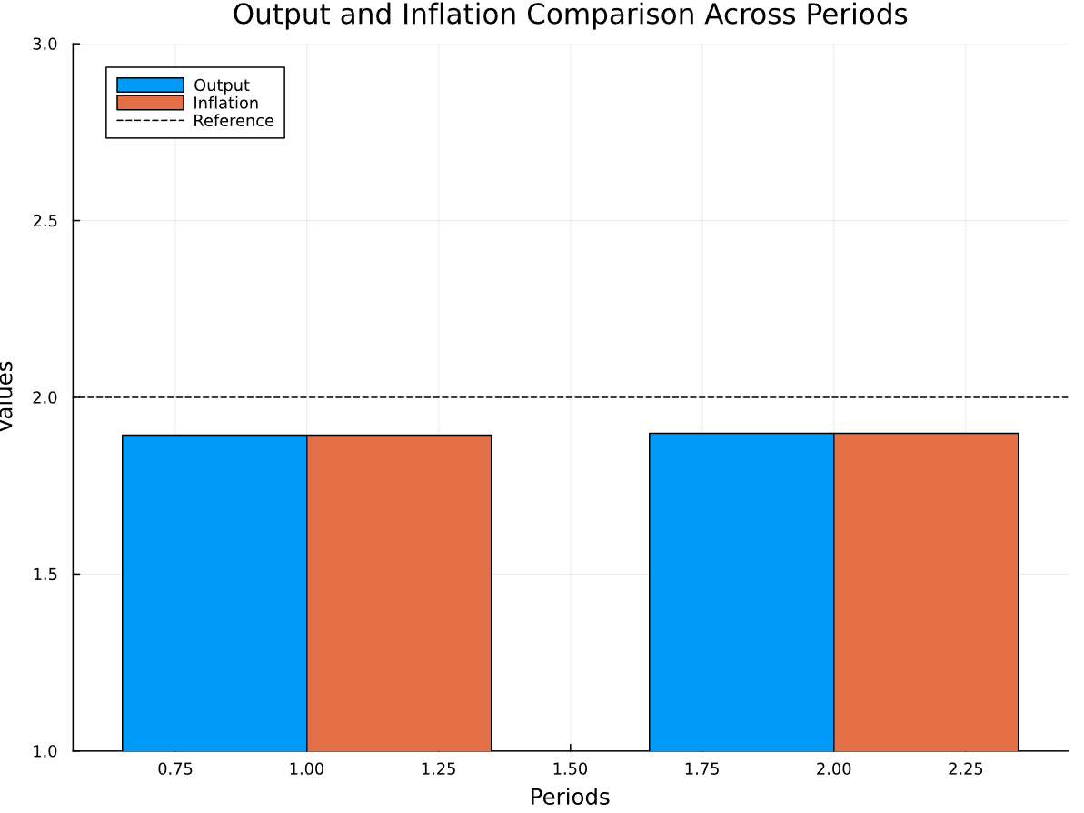
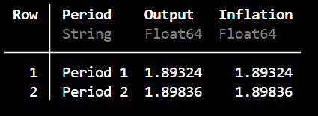
Early two-choice results (demand shock)
Output and inflation very slightly lower than in NE (1.9) and cooperative outcome (1.95).
However, it is closer to optimal than when only one authority pre-commits (1.85).
Effects are small – but will grow significantly in a full infinite-horizon game.
Notes:
Describe in words that we have a model that is the same as above, however there is now an adjustment cost for changing your policy settings between stage 1 and 2. In both stages “demand” is low by the same amount, so the optimal policy should be symmetric. However, the strategic incentive does influence choices.
Why we coded the static game in R, have switched to Julia to solve this model, and will use Julia for the infinite horizon version.
Note: Comparison here was to an earlier version of the static game – not using this anymore as we have the full dynamic game solved.

Slide 28
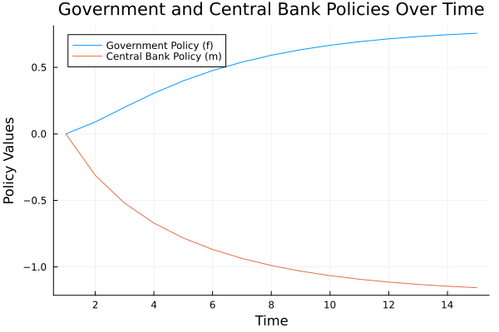
Transition dynamics (same simple model)
Inflation only shock. No intertemporal strategic behaviour.
Demand persistently “too low”, such that inflation is below target but output at target.
Policy makers “offset” each other – with adjustment cost constraining how far they move each period.
Convergence relies on a penalty from neutral.
Notes:
This is not the dynamic game, it is the transition dynamics from the initial equilibrium where inflation and output are at target and both policies are zero, to the Nash Equilibrium when gamma has fallen to 1.5. In other words, this is the same Nash Equilibrium as before, but it is costly for agents to adjust their policy from the prior level and so it takes time to adjust.
The purpose of this is to show how adjustment costs influence the choice of the agents – and even in games without intertemporal strategic behaviour, we see interesting responses to shocks.
This does not consider how an agent sets their policy in order to influence the future policy of the other agent. As a result, there is no intertemporal strategic element (i.e. this isn’t the dynamic game yet). However, the addition of adjustment costs already provides interesting dynamics in the transition to the steady state (which is the NE). This is what we are solving with the dynamic game at present.

Slide 29
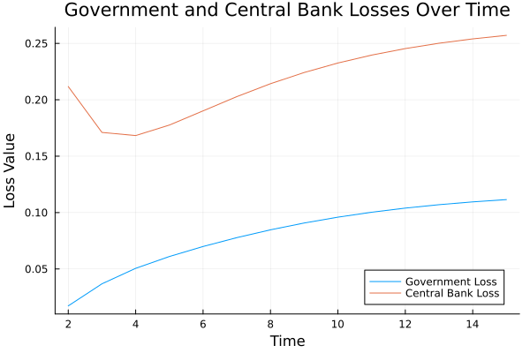
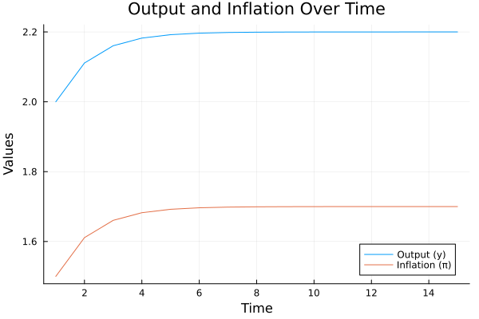
Transition dynamics (same simple model)

Slide 30



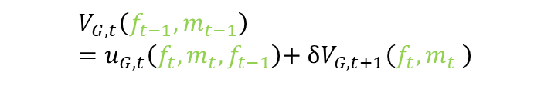
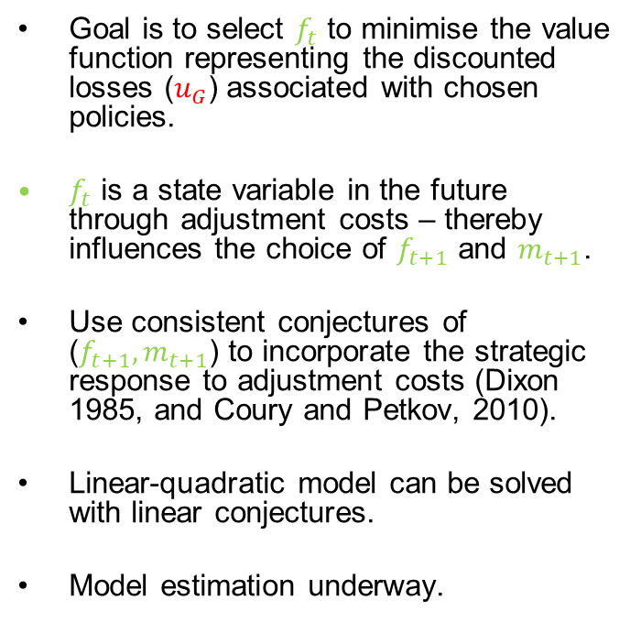
Initial dynamic game
Bellman equation for fiscal authority
Goal is to select $f_{t}$ to minimise the value function representing the discounted losses ($u_{G}$) associated with chosen policies.
$f_{t}$ is a state variable in the future through adjustment costs – thereby influences the choice of $f_{t+1}$ and $m_{t+1}$.
Use consistent conjectures of ($f_{t+1},m_{t+1}$) to incorporate the strategic response to adjustment costs (Dixon 1985, and Coury and Petkov, 2010).
Linear-quadratic model can be solved with linear conjectures.
Model estimation underway.
$$V_{G,t}\left(f_{t−1},m_{t−1}\right)=u_{G,t}\left(f_{t},m_{t},f_{t−1}\right)\text{+ }δV_{G,t+1}\left(f_{t},m_{t} \right)$$
Euler equation for fiscal authority
Notes:
Consistent conjectures are when a player makes a conjecture about the form of the response of the other player to their action – we then iterate the model to make sure those conjectures are “consistent” with rational choice.
Can read the three terms of the Euler equation as: 1) The static optimization term (FOC, marginal loss set to zero in static game).
2) The optimal response of the fiscal authority through the optimal choice of f and m in the following period.
3) The optimal readjustment of f to the strategic response of m.

Slide 31
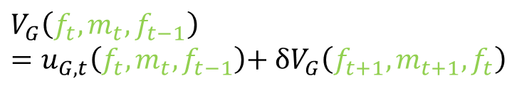
Logic of adjustment costs
Bellman equation for fiscal authority
Why would you impose an adjustment cost on yourself?
Menu cost logic – a small cost can prevent an individual from moving to their optimum point.
Pre-commitment – by imposing this cost on their future selves, a policy maker can commit to a known point that differs from their static Nash Equilibrium.
$$V_{G}\left(f_{t},m_{t},f_{t−1}\right)=u_{G,t}\left(f_{t},m_{t},f_{t−1}\right)\text{+ }δV_{G}\left(f_{t+1},m_{t+1},f_{t}\right)$$
Euler equation for fiscal authority
Notes:
Consistent conjectures are when a player makes a conjecture about the form of the response of the other player to their action – we then iterate the model to make sure those conjectures are “consistent” with rational choice.

Slide 32
Dynamic game with “insufficient demand”
Notes:
XXX

Slide 33
Dynamic equilibrium with varying adjustment costs
Notes:
XXX

Slide 34
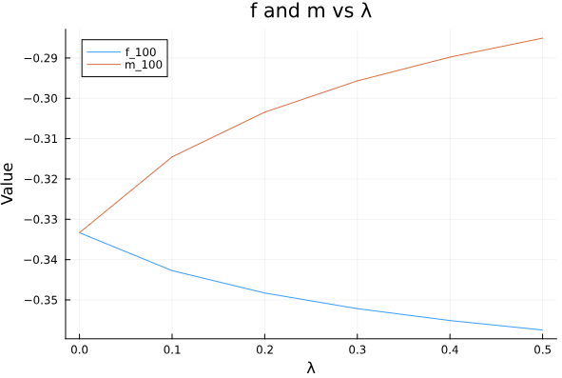
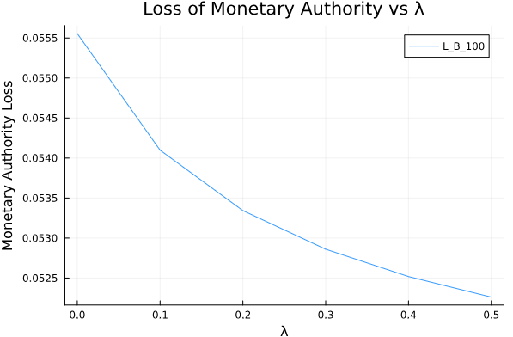
Incentive for leadership
If it was costless to adjusted fiscal policy
As adjustment cost of m rises, m falls.
But also f rises.
Adjustment cost used to commit to “doing less”
The “loss” to the monetary authority declines as the adjustment cost rises – incentive to make instrument too sticky.
Notes:
XXX

Slide 35
HANK applications
The key insight is around a fiscal policy response to inequality induced by monetary policy actions. We can conceptualise this as:
Perfect offset of income effects: this would leave monetary policy functioning only through intertemporal substitution.
Imprecise payments: in order to compensate for interest rate changes fiscal authorities may be unable to target payments – and so may need to give lump sum or general payments.
The related increase in aggregate demand to deal with “distributional concerns” of monetary policy could generate excess sensitivity in interest rates – and may be framed as a “prisoners dilemma”
This would then quantify how much central banks may “restrict” their purity in chasing inflation in order to limit distributional consequences.
Notes:
“prisoners dilemma” , where both monetary and fiscal authorities would have been better off if they had not tried to counteract each others policy.
First solve the RANK model with output and inflation
Then look to extend into a HANK approach, allows us to include inequality as a target.

Slide 36
Next steps
Complete dynamic model and simulate for varying shocks.
Endogenise the choice of adjustment costs.
Incorporate into a macro-model to more formally model the economy. Use this to describe conflict in optimal policy rules, and how this varies based on the nature of shocks.
A separate piece of work trying to understand how broadening policy rules may work – use a HANK model to include a target for income/wealth inequality in the loss function.

